Slide 1
Theory of Filtration, Dialysis, and Membranes
Team 4
Daniel Ivanov, Aaron Forest, Jillian Schwartz, Catherina Samson

Slide 2
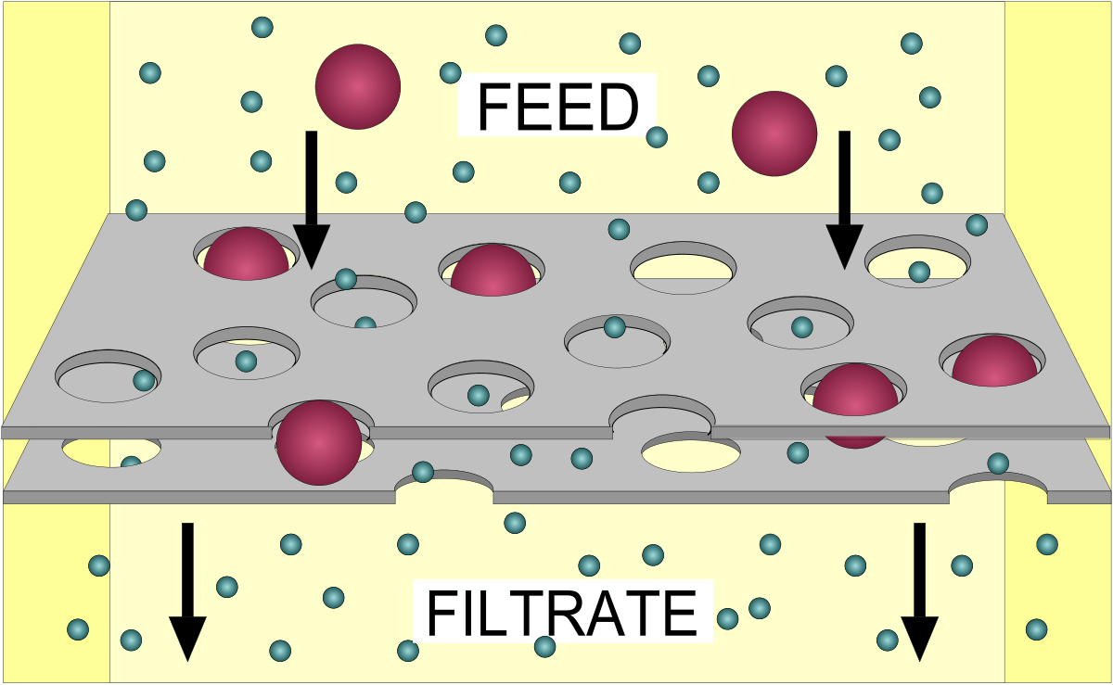
Fundamentals of Filtration
Separate solid particles (impurities) from a fluid
Employs a filter medium that is porous
Molecules larger than pores are trapped
Molecules smaller than pores pass through filter
Industry Examples:
Oil filtration
Catalyst recovery
Water treatment
https://en.wikipedia.org/wiki/Filtration

Slide 3
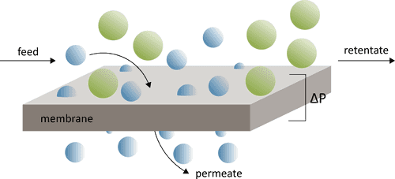
Fundamentals of Membrane Separations
Utilizes semi-permeable membranes to selectively separate certain components from a fluid mixture
Separation is based on differences in molecule size, concentration, or charge
Industry Examples:
Nitrogen production from air
Pharmaceutical purification
Dairy processing
https://openmembranedatabase.org/membrane-science/

Slide 4
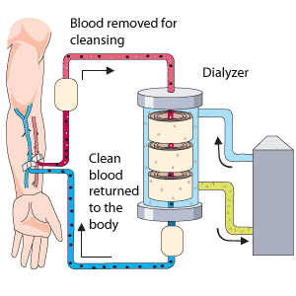
Fundamentals of Dialysis
Procedure used to remove waste products, excess fluids, and electrolytes
Separation based on concentration gradient
Commonly used in medical settings for kidney related issues
https://www.medbroadcast.com/procedure/getprocedure/hemodialysis

Slide 5
Driving Forces
Concentration Gradient
Solute concentrations on either side of a separator can drive the diffusion of solutes through the separator
Pressure Difference
Pressure difference across a separator can drive the movement of solvents or solutes through the separator
Electric Potential
Voltage difference across a separator can drive the movement of charged particles through ion-selective separator

Slide 6
Design Equations: Porous Diffusion
Membrane thickness
Flux of solute i across the membrane for liquid diffusion through pores
Concentration gradient across the membrane
Porosity
Diffusion coefficient
Effective Diffusion
Tortuosity
Unitless restrictive factor
Molecular diameter/pore diameter
All equations taken from Seader, et al.

Slide 7
Design Equations: Bulk Diffusion
Density of solvent
Pore diameter
Viscosity of solvent
Flux of solute i across the membrane for bulk flow where 𝜏 = 1
Path of pore
Pressure gradient across the membrane
Flux of solute i across the membrane for bulk flow where 𝜏 > 1
Specified surface area
All equations taken from Seader, et al.

Slide 8
Design Equations: Dialysis
Overall mass-transfer coefficient
Differential rate of solute mass transfer across the membrane
Total membrane surface area
Permeability
All equations taken from Seader, et al.

Slide 9
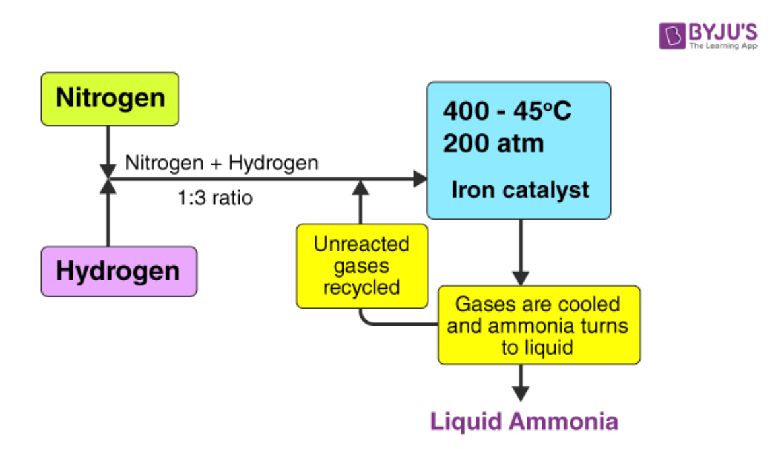
Overview of Haber-Bosch Process
https://byjus.com/chemistry/haber-process

Slide 10
How are Filtration, Dialysis, and Membranes used in Ammonia Production?
Filtration, dialysis, and membranes function in very similar manners
Dialysis can be used to obtain specific ammonia concentrations/compositions
Filtration can be used to prep/purify feed streams
Membranes can be used to capture carbon dioxide produced during the hydrogen production

Slide 11
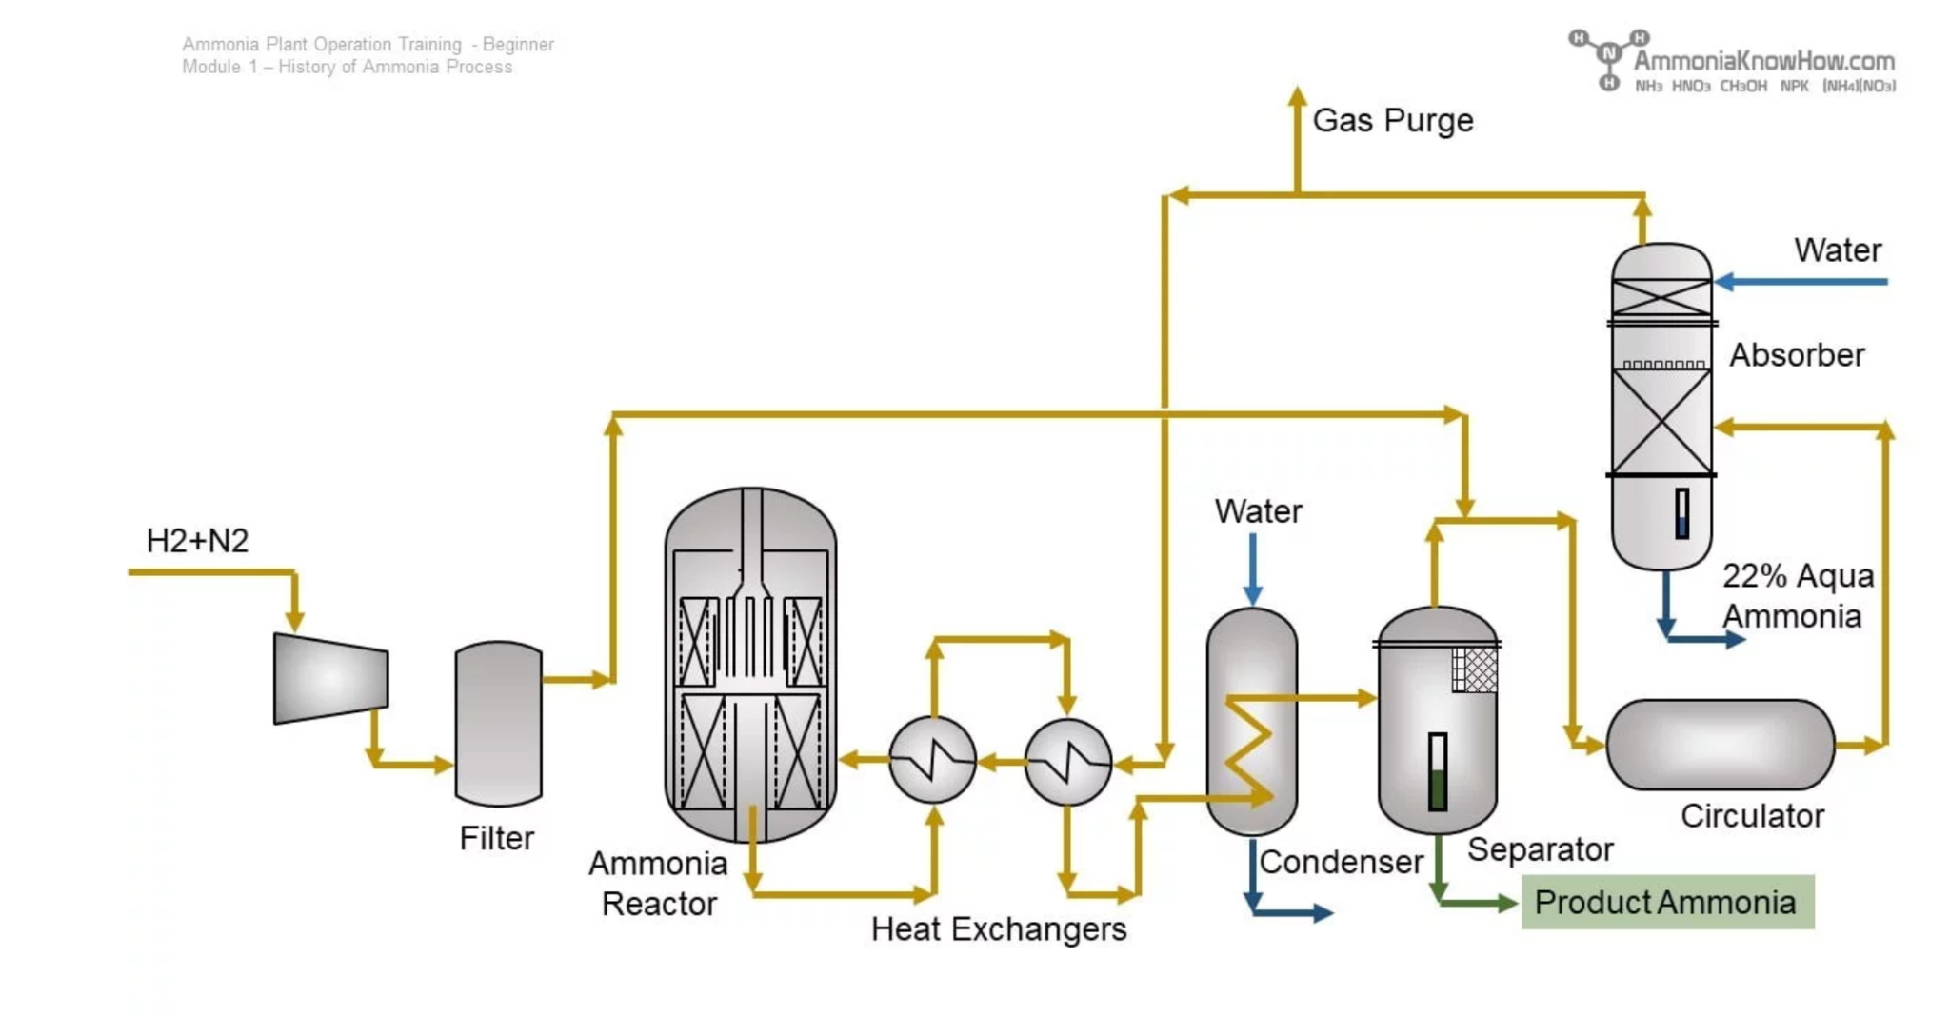
Filtration
Short history of ammonia process – past, present and future. AmmoniaKnowHow. (n.d.). https://ammoniaknowhow.com/short-history-of-ammonia-process-past-present-and-future/

Slide 12
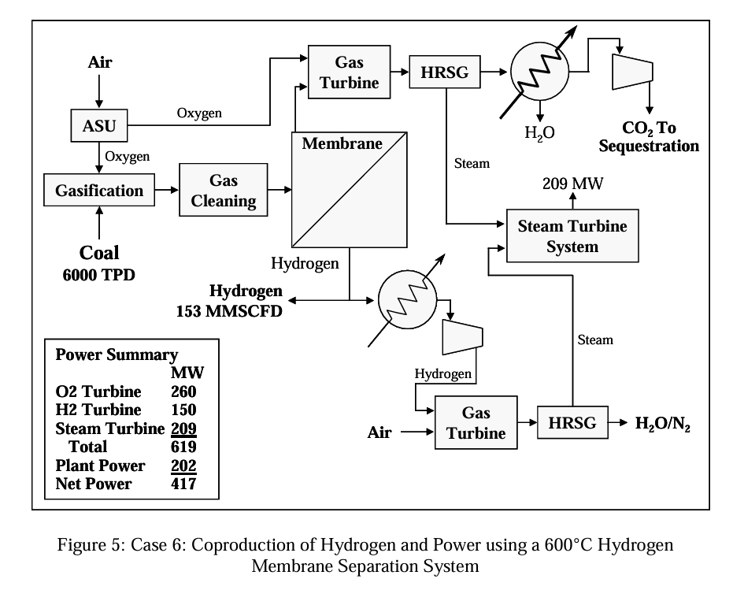
Membrane
https://netl.doe.gov/
Notes:
Goal: ammonia from coal with membrane-based CO2 removal
Used in the process of gasification to get H2 for ammonia production
Capture CO2 for sequestration
Coal + O2 → syngas H2
HRSG: heat recovery steam generator
ASU: air separation unit

Slide 13
Dialysis
Short history of ammonia process – past, present and future. AmmoniaKnowHow. (n.d.). https://ammoniaknowhow.com/short-history-of-ammonia-process-past-present-and-future/

Slide 14
Questions??

Slide 15
Citations
Introduction to ammonia production. AIChE. (2019, February 1). https://www.aiche.org/resources/publications/cep/2016/september/introduction-ammonia-production
Preparing your download. ScienceDirect.com. (n.d.). https://www.sciencedirect.com/science/article/pii/S1876610217319525/pdf?md5=fac2cbbdef2b9374983d8f6cca5d1803&pid=1-s2.0-S1876610217319525-main.pdf
Short history of ammonia process – past, present and future. AmmoniaKnowHow. (n.d.). https://ammoniaknowhow.com/short-history-of-ammonia-process-past-present-and-future/
Seader, J. D., et al. Separation Process Principles. John Wiley & Sons, Inc., 2011.

